Slide 1

The Diffusion of pollution into the atmosphere
Brian Cash, g01032058, 4/28/21

Slide 2
The problem
Point source pollution is a problem with many difficult factors to consider. However, currently the importance of undertaking a large green movement worldwide needs to be informed with an understanding of how exactly pollution diffuses from the source it comes from.
This is difficult to accomplish using purely sensors and emissions inventory, so therein lies the problem:
How can we model this process to gain a better understanding of the real-life phenomena?

Slide 3
Why this topic and problem matters
In our daily lives, there are many sources of pollution mixing into our air. However, we never really stop and consider how it diffuses into the air we breath as the atmosphere is a free and open system. Does a car pollute our air the same way a Chimney of a Power Plant? As we enter this era of bringing new green solutions to fixing our climate change problem, we need to remember how exactly these different pollutions affect the problem itself so we can fix the problem right the first time around.

Slide 4
Why use molecular dynamic Modeling?
“Air laden with visible pollution can transform into clear, blue skies within hours by a sudden change in the weather, such as the passage of a weather front. It is obvious, therefore, that air pollution is a dynamic problem.”
- Lixin FU and Yang CHEN Department of Environmental Sciences and Engineering, Tsinghua University, Beijing, P. R. China
The nature of the problem of air pollution is a physics problem based in a dynamic field. It is therefor necessary to address the root of this situation within it’s defined states, which makes molecular dynamics a key tool in gaining better understandings of this phenomena.

Slide 5
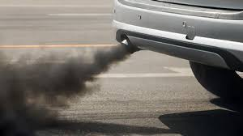
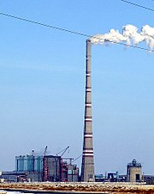
Factors to consider
With this problem in mind, there are some factors to consider when thinking about pollution diffusing into the air. Some of which are:
Differing heights at which pollutant is introduced to the outside system. How does atmospheric pressure change this?
Outside forces that may act upon the diffusion process. How does wind affect this?
These factors can affect the molecular velocity and direction in which pollutants enter the outside system. However, it may be possible to parameterize some of these factors.
.305 meters
Here we have two point pollution sources that vary both in type of pollution and height at which pollution is introduced to the outside system.
420 meters

Slide 6
Methods and models
PUFF Modeling – I used puff modeling in python to simulate how particles from each of these point pollutions may diffuse from the area in which they are released over time. This is a good dynamically moving model.
Gaussian Plume Modeling – This is a statistical model to show the area in which pollution from a source will spread by measuring its dispersion and flow rate using gaussian distributions. This modeling was done in R for the statistical toolkits it has. This is a good static model.
Both models are the basis of the most preferred models used by the EPA, like CALPUFF and AEROMOD.

Slide 7
Pros and cons
Gaussian Plum Modeling
PUFF Modeling
Pros:
Uses statistics to gauge length traveled for plume.
Measure’s density as pollution goes out.
Cons:
Static representation.
Generalizes shape of the plume.
Pros:
Dynamic representation of pollution particles.
Uses real wind data to process wind advections and dispersions.
Cons:
Wide grid points of gaussian grid for wind data causes problems for small scale models.
Empirical values that needed to be estimated.

Slide 8
Data- Gaussian Plume Model
Car Parameters
Fluestack Parameters
Source emission rate - 24.6861 g/s
Source height – 5 m (Based on length of car exhaust pipe)
Wind speed – 4.23 (m/s)
Pasquill Gifford Value – ‘C’
Diameter - 0.0762 m (tail pipe diameter)
Source emission rate – 297.51 g/s
Source height – 420 m (Based on Example)
Wind speed – 4.23 (m/s)
Pasquill Gifford Value – ‘C’
Diameter - 30 m (Chimney Diameter)

Slide 9
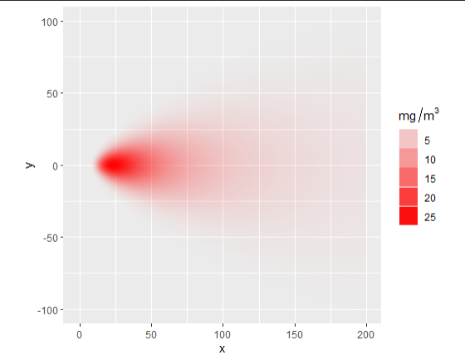
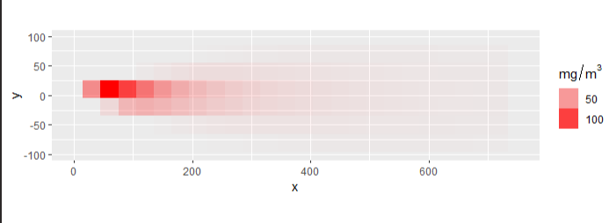
Results- Gaussian Plume Model
Car Results
Fluestack Results

Slide 10
Data- puff Model
Car Parameters
Fluestack Parameters
Particle amount- 5000
source height – .2 m
wind dynamics – 4D Wind Force file (Time, Altitude, Latitude, Longitude)
Orientation - horizontal
Particle amount- 5000
source height – 420 m (Based on Example)
wind speed – 4D Wind Force file (Time, Altitude, Latitude, Longitude)
Orientation - Vertical

Slide 11
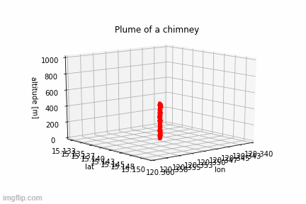
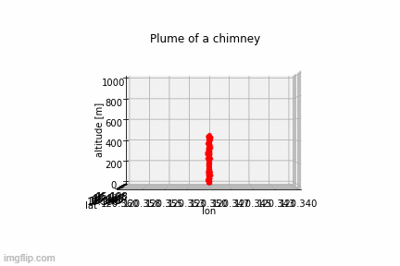
Results- Puff model for chimney/fluestack
Angled View
Side View

Slide 12
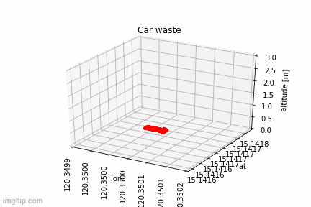
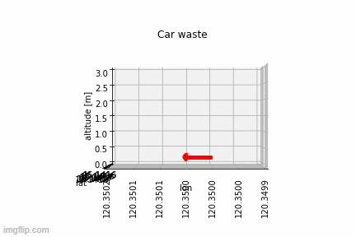
Results- Puff for car exhaust
Angled View
Side View

Slide 13
Results
Gaussian Plume Model
PUFF Model
While being the more stable of the two models I worked on, there were some significant results.
For cars, we can see that the pollution will reach out to about 200m which was a stated value by experts when I was working in the Opportunity Project in 2020. Furthermore, the density predictions fall in-between the empirically gained values of 18-40 mg/m^3. I believe these values to be accurate and valid.
For the chimney, given the calculations and came out accurate for the car example, I believe the chimney example is also accurate. This would indicate that even at 10X the amount of pollution per second, the chimney would boast better stats than 10 cars. However, the amount that reaches the 600-meter mark means that while it has some comparable stats, it is still reaching further distances which the cars will not unless it drives past said distance.
While the error with the particles lowering too much exists with the chimney example due to interpolation problems, we do get to see a pretty good representation of the differences between the two point-sources.
We see how the car exhaust particles do move away and spread however in certain areas the particles will remain in a gas mass for a bit which is how pollution tends to act as it first is exhausted. We also see how this type of pollution doesn’t tend to rise immediately given the parameters used here, meaning this pollution is more likely to affect our breathing.
In the Chimney example we can see that the particles are more likely to diffuse outwards at its higher altitude, however these particles do settle into lower parts of the atmosphere as well. This type of pollution being so high up tends to affect greenhouse gas problems more than human health problems, but it still can affect human health as well.

Slide 14
Conclusions
Point source pollution near the layer of the atmosphere we live our daily lives in is comparably worse than that of point pollution in higher layers. However, the atmosphere is an open system and pollution in the higher layers can settle into the lower ones over time. With the larger distance that chimney pollution reaches, this upper hand is not very great.
A takeaway from this is how to diffuse and settle the argument about if electric cars are worse than regular cars. I can safely say the answer is no. While averagely a good fuel emission car in the US would have about 250 g/mi for its CO2 rating while a regular Tesla Model 3 would have about 100 g/mi of CO2 based off its energy consumption (in Northern Virginia, can vary from area to area given energy practices). Even if it is sourcing all it’s energy from plants that pollute through chimneys into the atmosphere, it is still arguably better than having 10-100 cars polluting at even higher rates than the ones I modeled polluting into the lower atmosphere.
There are plenty of other health risks these results can speak to, but this is just one of the conclusions I’ve decided to show.

Slide 15
Future work/improvements
In the future, I would like to see if differing pollutants would show major differences to the chimney model.
The PUFF model needs a lot more optimization to run faster and compute more reasonable results. Settling terms were hardcoded to a much larger model and were very difficult to fit for my model.
Finding better wind data for the small-scale interpretations I need.
Finding more empirically done studies to find more accurate dispersion terms.

Slide 16
Cited sources
Environmental Protection Agency. Revisions to the Guideline on Air Quality Models: Enhancements to the AERMOD Dispersion Modeling System and Incorporation of Approaches To Address Ozone and Fine Particulate Matter , vol. 82, no. 10, 17 Jan. 2017, pp. 1–54., www.epa.gov/sites/production/files/2020-09/documents/appw_17.pdf.
Fu, Lixin, and Yang Chen. AIR POLLUTION DYNAMICS AND MODELING, pp. 1–5., www.eolss.net/sample-chapters/C09/E4-11-05-01.pdf.
Kwong, Jeffrey. “PUFF MODEL Material.” Jeffreys and His Cats Website, University of Illinois, 2015, publish.illinois.edu/pillsburydoughcat/puff-model/puff-model-supplementary-material/.
“On the Environmental Safety of Automobile Vehicles.” Https://Unece.org/, United Nations Economic Commission for Europe, 11 Nov. 2013, unece.org/DAM/trans/doc/2013/wp29/WP.29-161-22e.pdf.
“Greenhouse Gas Emissions from Electric and Plug-In Hybrid Vehicles – Results.” Www.fueleconomy.gov - the Official Government Source for Fuel Economy Information, Environmental Protection Agency, www.fueleconomy.gov/feg/Find.do?year=2020&vehicleId=42274&zipCode=22306&action=bt3.

